Slide 1
Spam Email Detection
Parker Lutz
University of Central Florida MSDA
STA 5703 Final Project

Slide 2
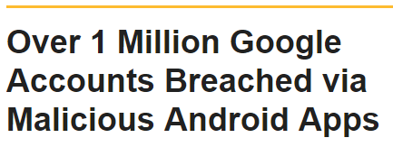
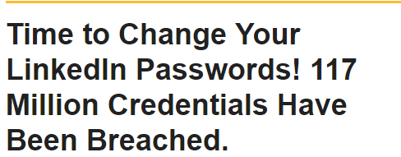
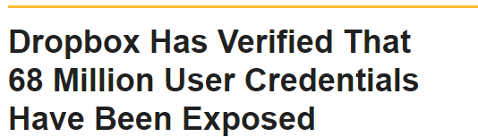
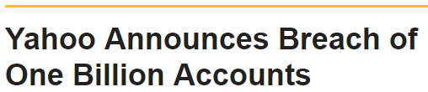
Data breaches in the headlines

Slide 3
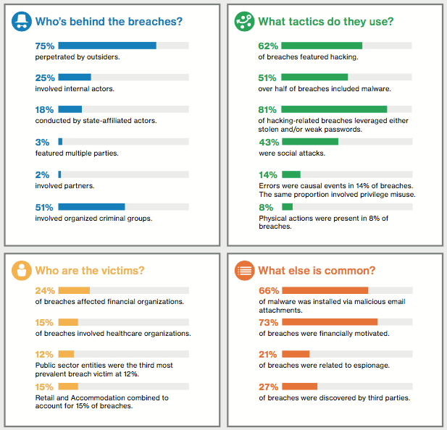
2017
Verizon Data Breach Investigations Report

Slide 4

Determine if an email is spam
Best achieved: 97% accuracy with 7% misclassification
Optimize high accuracy and reduce false positives
Dataset from 1999
Attributes captured: Word Frequency, Character Frequency, Pattern Length
Assess correct datatypes
Split into test/train
Click the link below to WIN $1,000 FOR FREE!!!

Slide 5
LDA and QDA
LINEAR DISCRIMINANT ANALYSIS
QUADRATIC DISCRIMINANT ANALYSIS
 | Not Spam | Spam
Pred: Not Spam | 349 | 52
Pred: Spam | 25 | 175
 | Not Spam | Spam
Pred: Not Spam | 357 | 148
Pred: Spam | 17 | 79
 | Performance
False Positive | 12.5%
False Negative | 13.0%
Accuracy | 87.2%
 | Performance
False Positive | 17.7%
False Negative | 29.3%
Accuracy | 72.5%
QDA is more flexible but exerts bias when boundary is truly linear

Slide 6
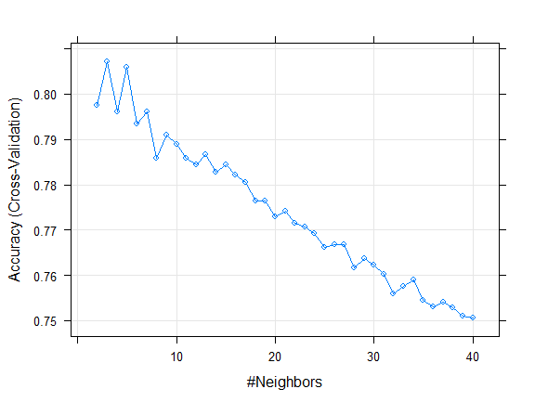
K Nearest Neighbors
Highest accuracy achieved at k=2
More flexible than LDA and QDA
 | Not Spam | Spam
Pred: Not Spam | 344 | 39
Pred: Spam | 30 | 188
 | Performance
False Positive | 13.8%
False Negative | 10.2%
Accuracy | 88.5%

Slide 7
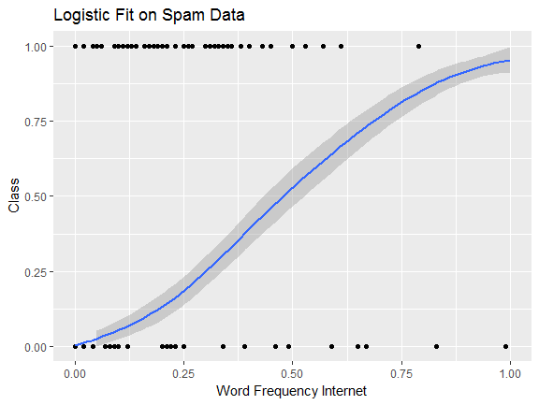
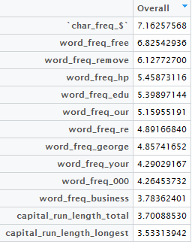
Logistic regression
Best performance
Interesting to view variable importance
 | Not Spam | Spam
Pred: Not Spam | 345 | 32
Pred: Spam | 18 | 206
 | Performance
False Positive | 8.0%
False Negative | 8.5%
Accuracy | 91.7%

Slide 8
Optimizing error rates
Threshold = 0.60
Threshold = 0.97
 | Not Spam | Spam
Pred: Not Spam | 349 | 37
Pred: Spam | 14 | 201
 | Not Spam | Spam
Pred: Not Spam | 363 | 124
Pred: Spam | 0 | 114
 | Performance
False Positive | 6.5%
False Negative | 9.6%
Accuracy | 91.5%
 | Performance
False Positive | 0.0%
False Negative | 25.5%
Accuracy | 79.4%

Slide 9
bibliography
Lichman, M. (2013). UCI Machine Learning Repository [http://archive.ics.uci.edu/ml]. Irvine, CA: University of California, School of Information and Computer Science.
Mukherjee, S. (2017, January 09). Foreign Government Likely Behind Huge 2015 Anthem Data Breach: Report. Retrieved May 01, 2017, from http://fortune.com/2017/01/09/anthem-cyber-attack-foreign-government/
Rashid, F. Y. (2017, April 27). Annual Verizon security report says sloppiness causes most data breaches. Retrieved May 01, 2017, from http://www.infoworld.com/article/3193028/security/annual-verizon-security-report-says-sloppiness-causes-most-data-breaches.html
Sjouwerman, S. (n.d.). Security Awareness Training Blog. Retrieved May 01, 2017, from https://blog.knowbe4.com/verizon-2016-data-breach-report-phishing-tops-the-list-of-increasing-concerns

